Slide 1
ADS Project 3
Weakly supervised learning -- label noise and correction
Ying Gao, Alix Leon, Shreya Sinha, Weijia Wang, Tomasz Wislicki

Slide 2
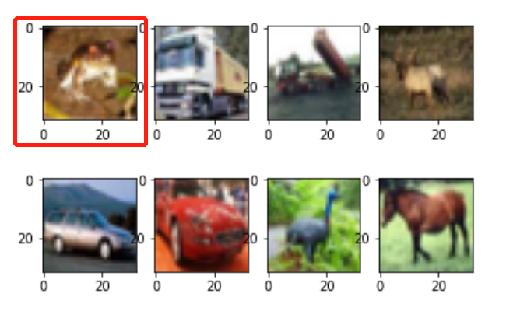
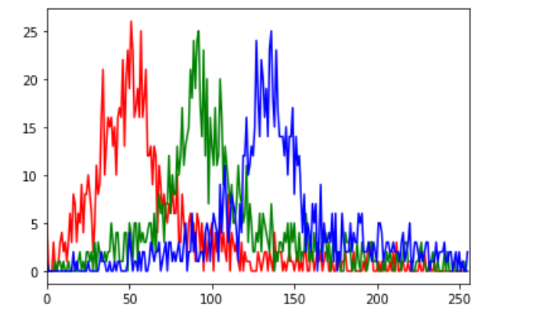
Data Preprocessing
Dimensions: (32, 32, 3)

Slide 3
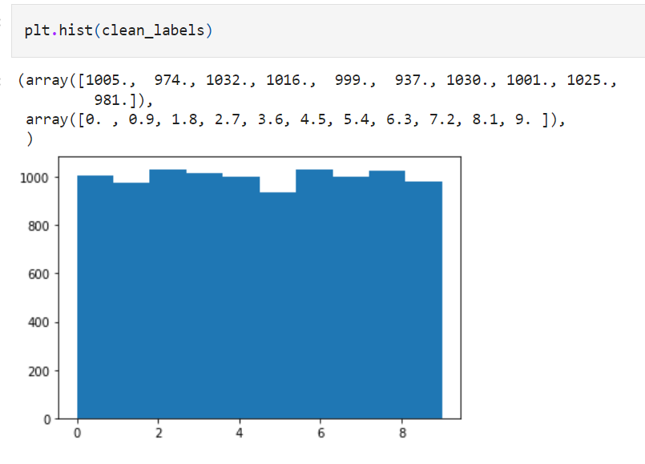

Slide 4
Model Selection
Baseline Model: Logistic Regression
Model1: ResNet18
Model2: ResNet18 + Image Classifier + Label Cleaner

Slide 5
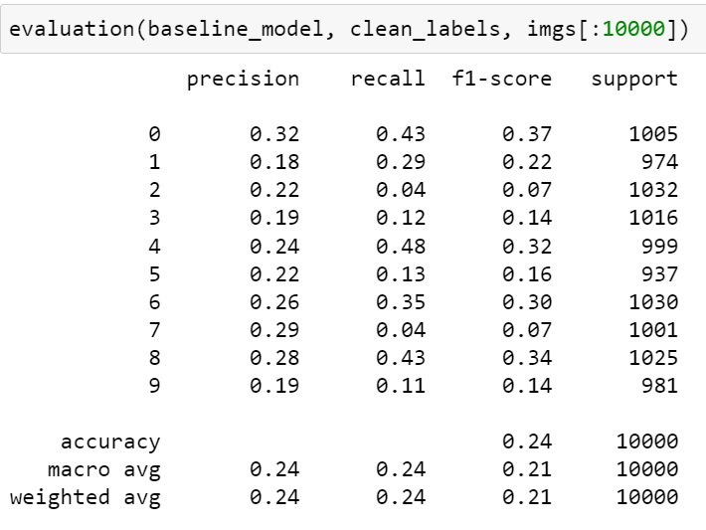
Baseline Model: Logistic Regression

Slide 6
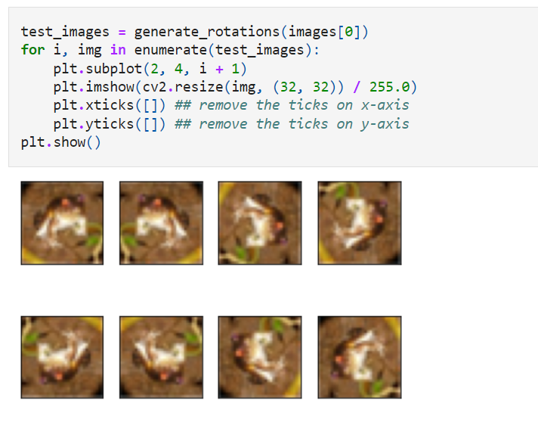
Data Augmentation

Slide 7
Model Selection: Model 1
Model | Number of Epochs trained | Accuracy
CNN | 58 | 0.6300
ResNet18 | 44 | 0.48
EfficientNet | 20 | 0.2227
MobileNet | 20 | 0.1019
VGG16 | 10 | 0.2539
ResNet101 | 10 | 0.1433
AlexNet | 10 | 0.1780

Slide 8
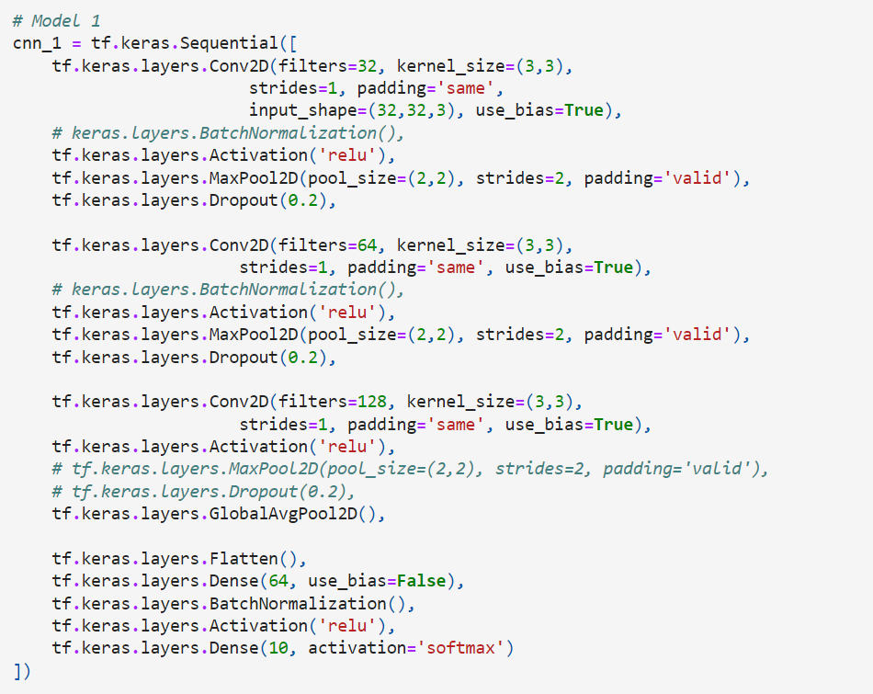
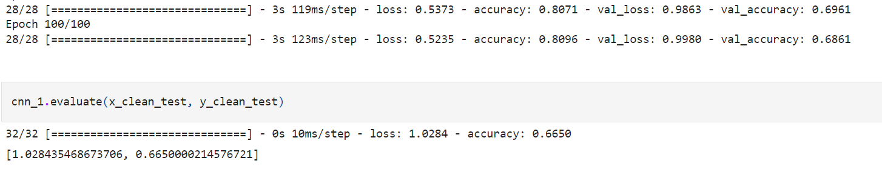

Slide 9
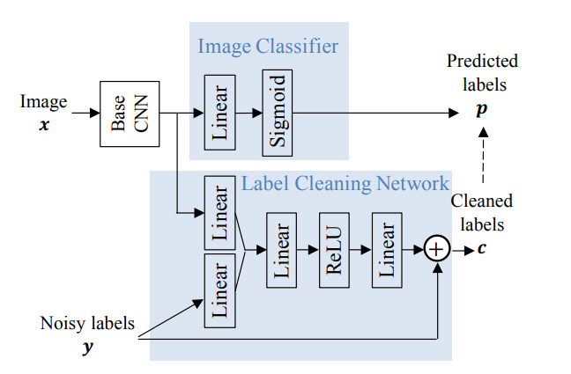
Model Selection: Model 2
Reference: Multi-Label Fashion Image Classification with Minimal Human Supervision

Slide 10
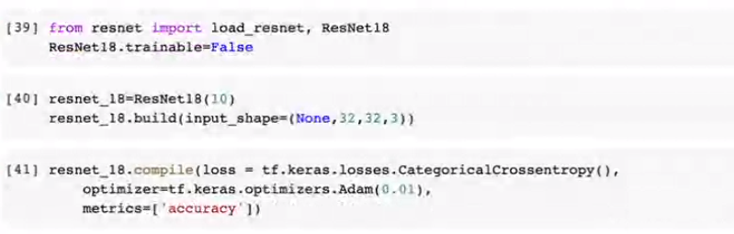
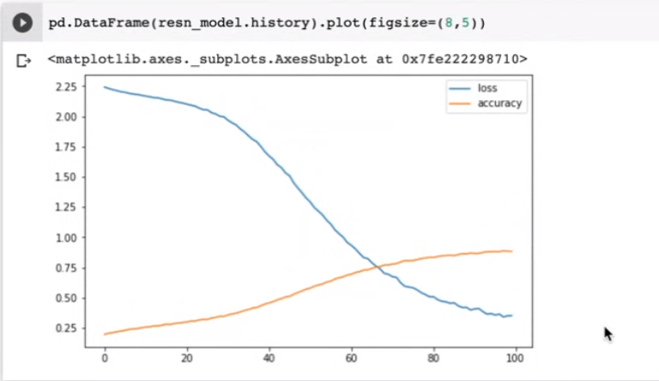
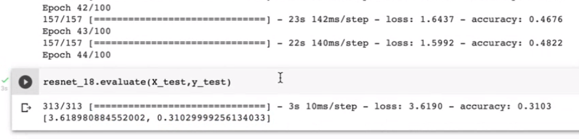
Model Selection: Model 1 Update - ResNet18

Slide 11
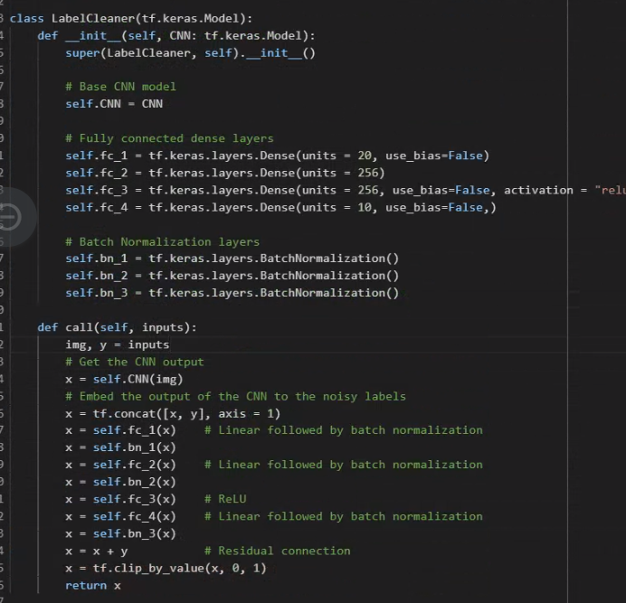
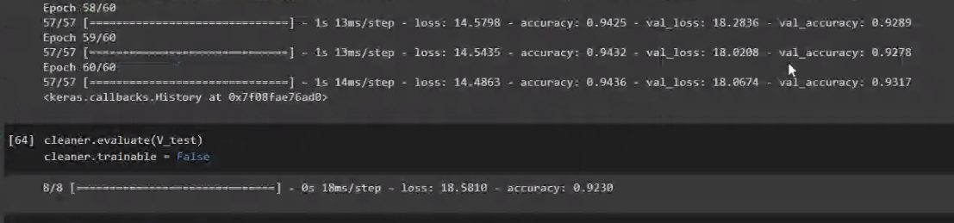
Model Selection: Label Cleaner

Slide 12
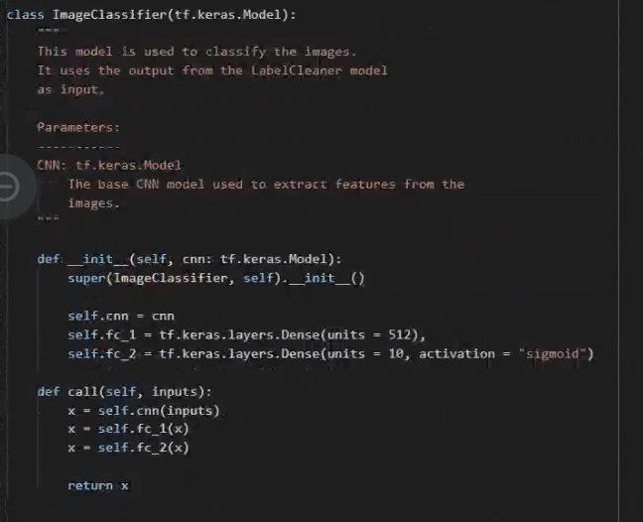
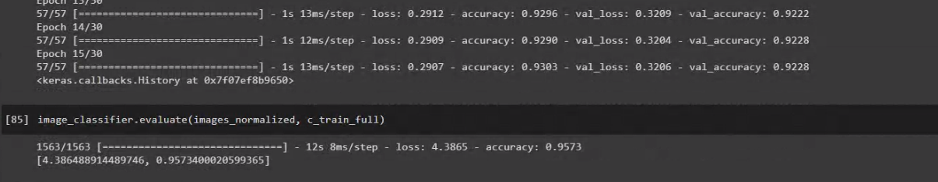
Model Selection: Image Classifier

Slide 13
